Slide 1
Data Warehousing and On-line Analytical Processing
Basic Concepts

Slide 2
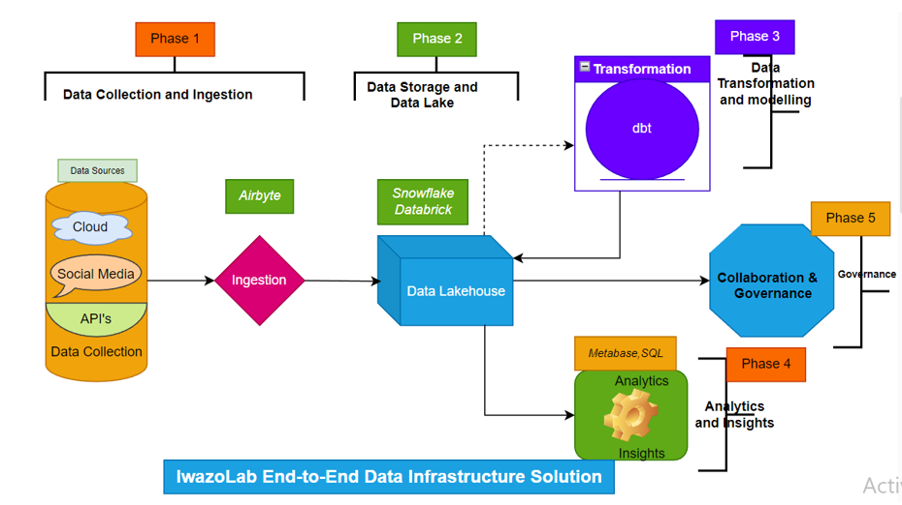

Slide 3
Databases
A database is a collection of (in some way related) data. In a DW they must contain a large volume of data, both historical and current
There are two types of databases that can be used to contain and manage data in DW:
• Relational - A database is called this way when the data elements and relationships that exist between them are recorded in tabular form. It is used both for transactional systems and DWs,
• Multi-dimensional- represents data in it as dimensions and not tables. It is easier to use and faster than a relational database. I

Slide 4
Data Warehouse
A data warehouse is a repository (data & metadata) that contains integrated, cleansed, and reconciled data from disparate sources for decision support applications, with an emphasis on online analytical processing. Typically the data is multidimensional, historical, non volatile.

Slide 5
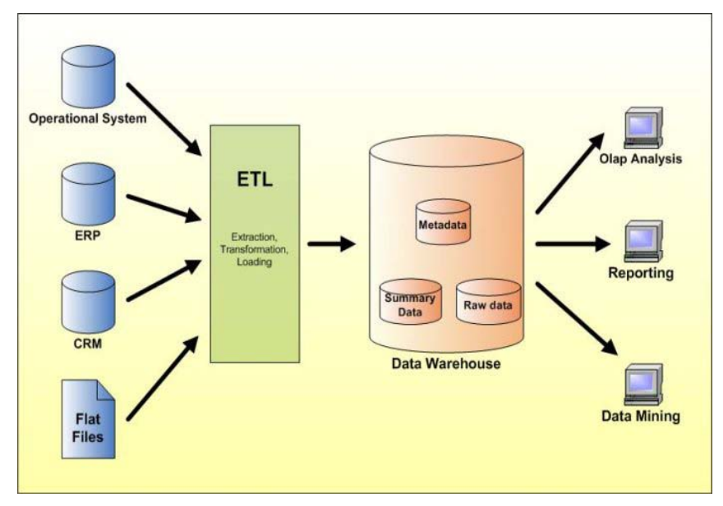
Data Warehouse architecture

Slide 6
Understanding a warehouse
A data warehouse is a database, which is kept separate from the organization's operational database.
There is no frequent updating done in a data warehouse.
It possesses consolidated historical data, which helps the organization to analyze its business.
A data warehouse helps executives to organize, understand, and use their data to take strategic decisions.
Data warehouse systems help in the integration of diversity of application systems.
A data warehouse system helps in consolidated historical data analysis

Slide 7
Why a Data Warehouse is Separated from Operational Databases
An operational database is constructed for well-known tasks and workloads such as searching particular records, indexing, etc.
In contract, data warehouse queries are often complex and they present a general form of data.
Operational databases support concurrent processing of multiple transactions. Concurrency control and recovery mechanisms are required for operational databases to ensure robustness and consistency of the database.
An operational database query allows to read and modify operations, while an OLAP query needs only read only access of stored data.
An operational database maintains current data. On the other hand, a data warehouse maintains historical data.

Slide 8
Three Data Warehouse Models
Enterprise warehouse
❑ Collects all of the information about subjects spanning the entire organization
It typically contains detailed data aswell as summarized data, and can range in size from a few gigabytes to hundreds of gigabytes, terabytes, or beyond
❑ Data Mart
❑ A subset of corporate-wide data that is of value to a specific groups of users
❑ Its scope is confined to specific, selected groups, such as marketing data mart
❑ Independent vs. dependent (directly from warehouse) data mart
❑ Virtual warehouse
❑ A set of views over operational databases
❑ Only some of the possible summary views may be materialized

Slide 9
Operational Processes-Extraction, Transformation, and Loading (ETL)
Data extraction
❑ get data from multiple, heterogeneous, and external sources
❑ Data cleaning
❑ detect errors in the data and rectify them when possible
❑ Data transformation
❑ convert data from legacy or host format to warehouse format
❑ Load
❑ sort, summarize, consolidate, compute views, check integrity, and build indicies and partitions
❑ Refresh
❑ propagate the updates from the data sources to the warehouse

Slide 10
Data Warehouse Features
Subject Oriented - A data warehouse is subject oriented because it provides information around a subject rather than the organization's ongoing operations. These subjects can be product, customers, suppliers, sales, revenue, etc. A data warehouse does not focus on the ongoing operations, rather it focuses on modelling and analysis of data for decision making.
Integrated - A data warehouse is constructed by integrating data from heterogeneous sources such as relational databases, flat files, etc. This integration enhances the effective analysis of data.

Slide 11
Data Warehouse Features
Time Variant - The data collected in a data warehouse is identified with a particular time period. The data in a data warehouse provides information from the historical point of view.
Non-volatile - Non-volatile means the previous data is not erased when new data is added to it. A data warehouse is kept separate from the operational database and therefore frequent changes in operational database is not reflected in the data warehouse. Note: A data warehouse does not require transaction processing, recovery, and concurrency controls, because it is physically stored and separate from the operational database.

Slide 12
Data Warehouse Applications
Financial services
Banking services
Consumer goods
Retail sectors
Controlled manufacturing

Slide 13
Terminologies
Metadata-Metadata is simply defined as data about data. The data that are used to represent other data is known as metadata. For example, the index of a book serves as a metadata for the contents in the book. In other words, we can say that metadata is the summarized data that leads us to the detailed data

Slide 14
Metadata Repository
Meta data is the data defining warehouse objects. It stores:
❑ Description of the structure of the data warehouse
❑ schema, view, dimensions, hierarchies, derived data defn, data mart locations and contents
❑ Operational meta-data
❑ data lineage (history of migrated data and transformation path), currency of
data (active, archived, or purged), monitoring information (warehouse usage statistics, error reports, audit trails)
❑ The algorithms used for summarization
❑ The mapping from operational environment to the data warehouse
❑ Data related to system performance
❑ warehouse schema, view and derived data definitions
❑ business terms and definitions, ownership of data, charging policies

Slide 15
Metadata Repository
Metadata repository is an integral part of a data warehouse system. It contains the following metadata:
Business metadata - It contains the data ownership information, business definition, and changing policies.
Operational metadata - It includes currency of data and data lineage. Currency of data refers to the data being active, archived, or purged. Lineage of data means history of data migrated and transformation applied on it
Data for mapping from operational environment to data warehouse - It metadata includes source databases and their contents, data extraction, data partition, cleaning, transformation rules, data refresh and purging rules.
The algorithms for summarization - It includes dimension algorithms, data on granularity, aggregation, summarizing, etc.

Slide 16
Terms
Data Cube
A data cube helps us represent data in multiple dimensions. It is defined by dimensions and facts. The dimensions are the entities with respect to which an enterprise preserves the records.
Data Mart
Data marts contain a subset of organization-wide data that is valuable to specific groups of people in an organization. In other words, a data mart contains only those data that is specific to a particular group.
For example, the marketing data mart may contain only data related to items, customers, and sales. Data marts are confined to subjects

Slide 17
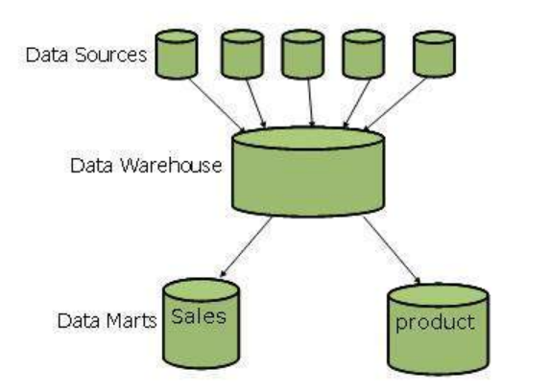
Data Marts
Data marts are small in size
Data marts are customized by department.
The source of a data mart is departmentally structured data warehouse.
Data marts are flexible.

Slide 18
Data cube example
A data cube is a multidimensional data structure that allows users to analyze data from different perspectives. It is typically used in data warehouses and business intelligence (BI) applications.
Consider a retail company that sells products in multiple stores to different customers. The company might have a data cube that contains the following dimensions:
Product
Store
Customer
Time period
The fact table in the data cube might contain the following measures:
Sales amount
Number of units sold
This data cube would allow the company to analyze its sales data from a variety of perspectives. For example, the company could use the data cube to answer the following questions:
What are the top-selling products in each store?
What are the most popular products among different customer segments?
How have sales changed over time?

Slide 19
Applications of Dat Cubes
Reporting
Data cubes can be used to create reports that summarize data from different dimensions. For example, a company could use a data cube to create a report that shows the total sales for each product category in each region.
Analytics
Data cubes can be used to perform complex analytics on data. For example, a company could use a data cube to identify trends in sales or to predict future sales.
Data mining
Data cubes can be used to mine data for patterns and insights. For example, a company could use a data cube to identify customer segments that are most likely to purchase certain products.

Slide 20
Data Warehouse Modeling: Data Cube and OLAP
A data warehouse is based on a multidimensional data model which views data in the form of a data cube
❑ A data cube, such as sales, allows data to be modeled and viewed in multiple dimensions
❑ Dimension tables, such as item (item_name, brand, type), or time(day, week, month, quarter, year)
❑ Fact table contains measures (such as dollars_sold) and keys to each of the related dimension tables
❑ Data cube: A lattice of cuboids
❑ In data warehousing literature, an n-D base cube is called a base cuboid
❑ The top most 0-D cuboid, which holds the highest-level of summarization, is called the apex cuboid
❑ The lattice of cuboids forms a data cube.

Slide 21
OLAP(Online analytical Processing)
OLAP is an approach to answering multi-dimensional analytical (MDA) queries swiftly.
OLAP is part of the broader category of business intelligence, which also encompasses relational database, report writing and data mining.
OLAP tools enable users to analyze multidimensional data interactively from multiple perspectives.

Slide 22
ROLAP
ROLAP databases can be used to analyze data from data warehouses that store epidemiological data, such as disease surveillance data, vaccination data, and mortality data. ROLAP databases can be used to answer a variety of epidemiological questions, such as:
What is the prevalence of a particular disease in a given population?
What are the risk factors for developing a particular disease?
How effective is a particular vaccine at preventing a particular disease?
What are the trends in disease prevalence over time?

Slide 23
MOLAP
MOLAP databases can be used to analyze large volumes of epidemiological data in real time. This is because MOLAP databases are optimized for OLAP queries. MOLAP databases can be used to answer a variety of epidemiological questions, such as:
What is the number of new cases of a particular disease in a given area in the past 24 hours?
What are the most common symptoms of a particular disease in a given population?
What is the geographic distribution of a particular disease?
How is a particular disease outbreak progressing over time?

Slide 24
HOLAP
HOLAP databases can be used to analyze both historical and real-time epidemiological data. This is because HOLAP databases combine the features of ROLAP and MOLAP databases. HOLAP databases can be used to answer a variety of epidemiological questions, such as:
What is the impact of a particular intervention on the prevalence of a disease?
What are the long-term trends in disease mortality?
What are the most common co-morbidities among patients with a particular disease?
What is the most cost-effective way to prevent a particular disease?

Slide 25
OLAP Analytical operations
Consolidation involves the aggregation of data that can be accumulated and computed in one or more dimensions. For example, all sales offices are rolled up to the sales department or sales division to anticipate sales trends.
The drill-down is a technique that allows users to navigate through the details. For instance, users can view the sales by individual products that make up a region’s sales.
Slicing and dicing is a feature whereby users can take out (slicing) a specific set of data of the OLAP cube and view (dicing) the slices from different viewpoints.

Slide 26
Types of OLAP
ROLAP works directly with relational databases. The base data and the dimension tables are stored as relational tables and new tables are created to hold the aggregated information. It depends on a specialized schema design
MOLAP stores this data in an optimized multi-dimensional array storage, rather than in a relational database. Therefore it requires the pre-computation and storage of information in the cube - the operation known as processing. MOLAP tools generally utilize a pre-calculated data set referred to as a data cube. The data cube contains all the possible answers to a given range of questions

Slide 27
Hybrid OLAP (HOLAP)
There is no clear agreement across the industry as to what constitutes Hybrid OLAP, except that a database will divide data between relational and specialized storage. For example, for some vendors, a HOLAP database will use relational tables to hold the larger quantities of detailed data, and use specialized storage for at least some aspects of the smaller quantities of more-aggregate or less-detailed data. HOLAP addresses the shortcomings of MOLAP and ROLAP by combining the capabilities of both approaches. HOLAP tools can utilize both pre-calculated cubes and relational data sources.

Slide 28
Conceptual Modeling of Data Warehouses
Modeling data warehouses: dimensions & measures
❑ Star schema: A fact table in the middle connected to a set of dimension tables
❑ Snowflake schema: A refinement of star schema where some dimensional hierarchy is normalized into a set of smaller dimension tables, forming a shape similar to snowflake
❑ Fact constellations: Multiple fact tables share dimension tables, viewed as a
collection of stars, therefore called galaxy schema or fact constellation

